Slide 1


Personal Finance Tool Using C Programming
Presented by:
Arnav Raghuvanshi:1262253103
Archit Nikam:1262254037
Rohan Kulkarni:1262253943
Narayani Deshpande:1262252444
Dhruv Agarwal:1262253305

Slide 2
Introduction to Financial Planning
Financial planning is the process of managing income and expenses to achieve financial goals. It includes:
Tracking income
Controlling expenses
Saving & investing
Managing debt
Proper planning ensures financial stability and security.

Slide 3
Need for the System
Common financial problems people face:
No money left at month-end
Living paycheck to paycheck
High EMI burden
Low savings
Our Personal Finance Tool helps solve these problems through structured budgeting.

Slide 4
Income & Expense Management
Enter Monthly Income
Enter Fixed Expenses
Primary income
Secondary income
EMI
Rent
Utilities
Insurance
→ System calculates total income
→ System calculates total expenses

Slide 5
Validation & Disposable Income
Validate Financial Inputs
No negative values
Expenses must not exceed income
Calculate Remaining Income
This amount is used for budgeting.

Slide 6




Budgeting Model & Allocation
Select Budgeting Model
Allocate Budget into Categories
Balanced Budget
A moderate approach, balancing saving and spending.
Transportation
Recreation
Aggressive Saving
Prioritizes maximum savings for rapid wealth accumulation.
Investment
Savings
Lifestyle-Oriented Budget
Focuses on spending for lifestyle choices while ensuring financial health.
System adjusts spending based on financial condition.

Slide 7
TECHNICAL FOUNDATION
The Building Blocks: Tools & Core Concepts
Programming Language
C Programming: Chosen for its efficiency, low-level memory management capabilities, and widespread use in system programming, providing a robust foundation for our tool.
Key C Programming Concepts Utilised
Variables
Conditional statements
For storing financial data like amounts, dates, and descriptions.
If-else statements and switch cases were used to handles multiple simultaneous cases.
Functions
To modularise code, managing specific tasks like adding income, recording expenses, or calculating totals.

Slide 8





CORE FUNCTIONALITY
Features of the Personal Finance Tool
Accept Income Details
The system allows the user to enter all sources of monthly income, including primary and secondary income, and calculates the total monthly income.
Accept Fixed Expense Details
The system collects details of fixed monthly expenses such as EMIs, rent, utilities, and insurance, and calculates the total fixed expenditure.
Validate Financial Inputs
The system validates all user inputs to ensure that values are non-negative and that total fixed expenses do not exceed the total monthly income.
Calculate Remaining Disposable Income
The system calculates the remaining income available for budgeting after deducting fixed expenses from total income.
Allocate Budget into Categories
Based on the selected budgeting model, the system divides the remaining income into different categories such as food, transportation, recreation, investment, and savings.

Slide 9





SYSTEM ARCHITECTURE
Understanding the Program Flow
Select Menu
Enter Data
Calculate
Summary
This sequential flow ensures a logical and intuitive user experience, guiding them through the finance management process from input to summary.

Slide 10
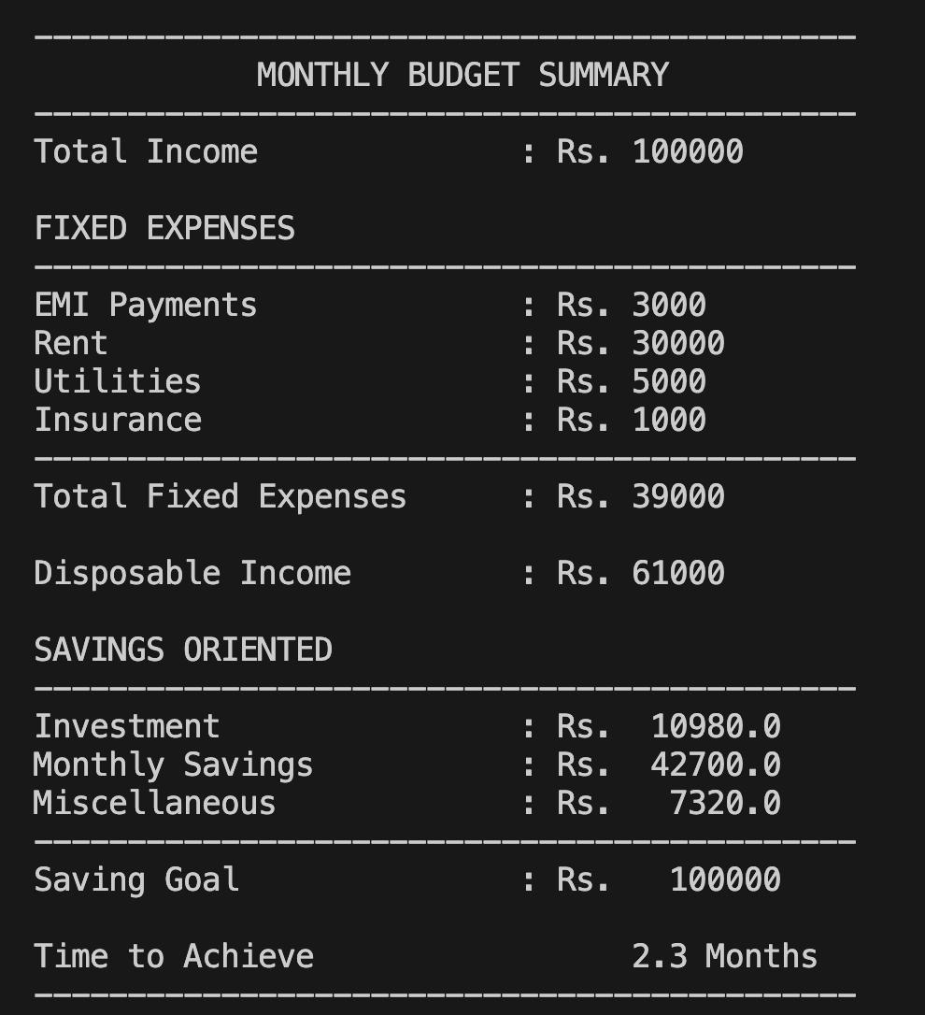
USER INTERFACE
Interactive Menu: Sample Output
Our tool presents a simple, menu-driven interface, allowing users to easily navigate through various functionalities. Here is an example of the command-line interface:
=================================
Personal Finance Manager
=================================
1. Add Income
2. Add Expense
3. View Current Balance
4. View Financial Summary
5. Save Data
6. Load Data
7. Exit
Enter your choice: _

Slide 11
THANK YOU

